Slide 1

MovieLens Fusion
An Integrated Movie Analytics Pipeline
DATA SCIENCE (24AD3107) Project Review-1
DATE: 22-09-2026 TIME: (9:00) AM
 | Under the Guidance of Ms. B PRATHYUSHA Assistant Professor, Department of Computer Science and Engineering, KLH CSE Bowrampet Campus
Team Members 2420030001 - DIKSHA YADAV 2420030332 - K. BHAVANA 2420030430 - G. TEJASHREE 2420030471 - N. NIKITHA REDDY

Slide 2
Outline of Project Work
Focus
Introduction
Literature Survey
Challenges
Research Objectives
Conclusion & Future Work
References
Publications Details

Slide 3
Problem Statement
Movie-related datasets contain valuable information about titles, genres, ratings, descriptions and other attributes. However, data collected from different sources often suffers from inconsistent schemas, missing values, duplicate records and incompatible formats, making reliable integration and analysis challenging.
Traditional approaches often focus on individual datasets or recommendation algorithms without giving sufficient attention to the complete data preparation and integration process.
MovieLens Fusion addresses this challenge by developing an integrated data engineering pipeline that:
Performs systematic data cleaning and quality validation.
Standardizes heterogeneous data structures and formats.
Identifies duplicate records and maintains data consistency.
Transforms and organizes movie information into a unified structure.
Stores processed data in a relational MySQL database.
Enables interactive analytics and movie exploration through a web application.

Slide 4
Objectives
The main objective of MovieLens Fusion is to develop an integrated data engineering pipeline that transforms raw movie data into a structured, reliable and analysis-ready dataset.
1. Data Collection: Gather movie-related information from available datasets.
Function: pd.read_csv()
2. Data Cleaning: Handle missing values, inconsistent entries and duplicate records.
Functions: isnull(), fillna(), drop_duplicates()
3. Data Transformation: Standardize column names, formats and data types.
Functions: rename(), astype(), withColumn()
4. Data Validation: Verify data completeness, consistency and correctness.
Functions: info(), count(), printSchema()
5. Data Integration: Organize movie information and genre relationships into a unified structure.
Functions: join(), groupBy(), explode()
6. Database Storage: Store processed movie information in relational MySQL tables.
Commands: CREATE TABLE, INSERT INTO, SELECT
7. Analytics & Visualization: Generate meaningful insights and interactive movie exploration.
Tools: SQL queries, Matplotlib, Plotly
8. Application Deployment: Provide an interactive web application using containerized services.
Tools: React, Flask, Docker, Docker Compose
Overall Goal: Build a modular, scalable and reliable movie analytics pipeline.

Slide 5
Literature Survey
Authors | Title of the Paper | Methodology | Inferences | Limitation / Future Work
Peralta [1] | Extraction and Integration of MovieLens and IMDb Data, Technical Report, 2007 | • Extracted MovieLens and IMDb data. • Performed data cleaning and transformation. • Matched movie titles across datasets. • Constructed an integrated database. | • Demonstrated MovieLens–IMDb integration. • Highlighted schema transformation and entity matching. • Reported that only 79% of movie-title matches were identical. | • Title matching was challenging. • Manual lookup was required for some records. • Automated entity matching can improve integration accuracy.
Harper & Konstan [2] | The MovieLens Datasets: History and Context, ACM TiiS, 2015 | • Examined MovieLens dataset development and characteristics. • Analyzed dataset usage and limitations. • Provided guidelines for research applications. | • Established MovieLens as a widely used research dataset. • Explained dataset structure and characteristics. • Highlighted important dataset limitations. | • Focused mainly on dataset history and usage. • Did not develop a complete data-integration pipeline. • Future work can explore integration with heterogeneous external sources.
Pérez et al. [3] | Improving Movie Recommendation Systems Filtering by Exploiting User-Based Reviews and Movie Synopses, 2020 | • Used MovieLens rating data. • Linked MovieLens identifiers with IMDb/TMDB content. • Combined movie plots with ratings. • Applied text preprocessing using NLTK. | • Demonstrated enrichment of MovieLens with external movie information. • Showed the usefulness of combining ratings and movie descriptions. • Highlighted the importance of preprocessing. | • Focused mainly on recommendation performance. • External metadata may contain missing or inconsistent records. • More systematic data validation can be explored.
Peralta [4] | Extraction and Integration of MovieLens and IMDb Data – Integrated Database Approach | • Defined source and target schemas. • Extracted and transformed heterogeneous movie data. • Applied movie-entity matching. • Stored integrated information in a relational database. | • Demonstrated transformation into a common schema. • Showed relational database construction after integration. • Provided a foundation for movie-data integration research. | • Title-based matching can create ambiguity. • Identifier-based matching can improve accuracy. • Automated integration techniques can reduce manual effort.
Rahm & Bernstein [5] | A Survey of Approaches to Automatic Schema Matching, The VLDB Journal, 2001 | • Reviewed schema-matching techniques. • Studied linguistic, structural and instance-based approaches. • Analyzed automatic matching methods. | • Explained the importance of schema matching in heterogeneous databases. • Identified different approaches for matching data attributes. • Provided a foundation for data integration systems. | • Different schemas may have ambiguous attributes. • Automatic matching may require domain knowledge. • Improved semantic matching can be explored.
Wang & Strong [6] | Beyond Accuracy: What Data Quality Means to Data Consumers, Journal of Management Information Systems, 1996 | • Studied data quality from the consumer perspective. • Identified different dimensions of data quality. • Developed a framework for evaluating data quality. | • Highlighted accuracy, completeness, accessibility and representation. • Demonstrated that data quality involves more than correctness. • Established important data-quality concepts. | • Provides a general data-quality framework. • Does not implement a movie-specific cleaning pipeline. • Domain-specific data-quality evaluation can be developed.

Slide 6
Problem Gap Identification
Existing movie analytics and recommendation systems mainly focus on recommending movies based on user ratings, preferences, and viewing history. However, several challenges remain in preparing movie data for reliable analysis.
1. Data Inconsistency: Movie datasets may contain different formats, column names, and data structures, making analysis difficult.
2. Missing Values: Important attributes such as director, cast, country, and rating may contain incomplete information.
3. Duplicate Records: Repeated movie records can affect data accuracy and analytical results.
4. Lack of Data Standardization: Movie information needs to be cleaned, validated, and transformed into a consistent structure.
5. Limited Data Quality Focus: Many existing approaches emphasize recommendation algorithms rather than the complete data cleaning and preparation process.
6. Limited Interactive Analytics: Users need an easy way to explore movie information, genres, and analytical results through an interactive application.
Identified Research Gap:
There is a need for a structured data engineering pipeline that focuses on movie data cleaning, validation, transformation, deduplication, database storage, and interactive analytics.
How MovieLens Fusion Addresses the Gap:
MovieLens Fusion aims to transform raw movie and TV show data into a clean, structured, and analysis-ready dataset using Python, Pandas, PySpark, and MySQL, with a web application for interactive movie exploration.

Slide 7
Innovation, Creativity, and Novelty
MovieLens Fusion: An Integrated Movie Analytics Pipeline introduces a structured approach to movie data processing by combining data engineering, database management, analytics, and web technologies.
1. Innovation
Combines data cleaning, transformation, validation, and storage into a single pipeline.
Uses both Pandas and PySpark for data processing.
Stores cleaned and structured movie data in a MySQL relational database.
Connects backend processing with an interactive React web application.
2. Creativity
Provides an interactive platform to explore movies and TV shows.
Organizes movie information based on genres and other attributes.
Uses visual analytics to make movie data easier to understand.
Provides a user-friendly interface for searching and exploring movie information.
3. Novelty
Focuses on the complete data engineering workflow rather than only movie recommendation algorithms.
Combines data quality management with large-scale data processing.
Creates a structured database from raw movie and TV show data.
Integrates data processing, storage, analytics, and web application deployment in one project.
Uses Docker to simplify application deployment and execution.

Slide 8
Feasibility and Project Plan
Factor | Feasibility
Data Availability | Publicly available movie and TV show datasets provide sufficient data for research and analysis.
Technology | Python, Pandas, PySpark, MySQL, Flask, React, and Docker support the development of the complete pipeline.
Computational Requirement | The pipeline can be developed and tested using standard computing resources.
Implementation | Modular stages allow data cleaning, transformation, storage, and analysis to be developed and tested separately.
Scalability | PySpark and modular architecture allow the pipeline to be extended to larger datasets.
Cost | Uses freely available datasets and open-source development tools, reducing implementation costs.

Slide 9
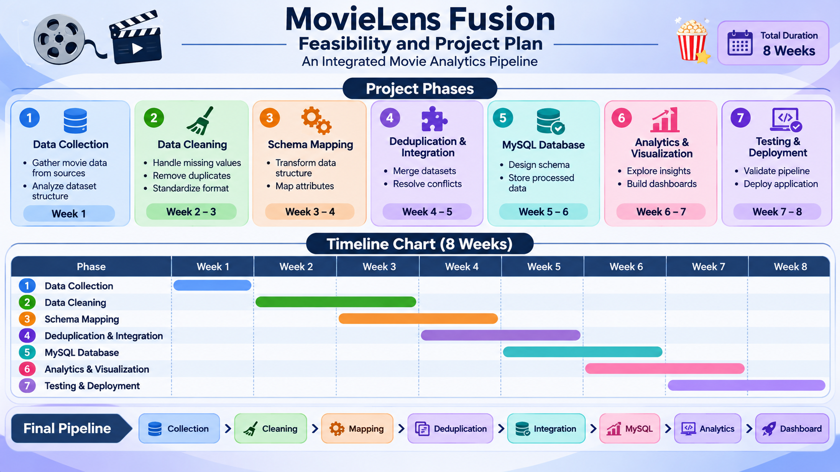

Slide 10
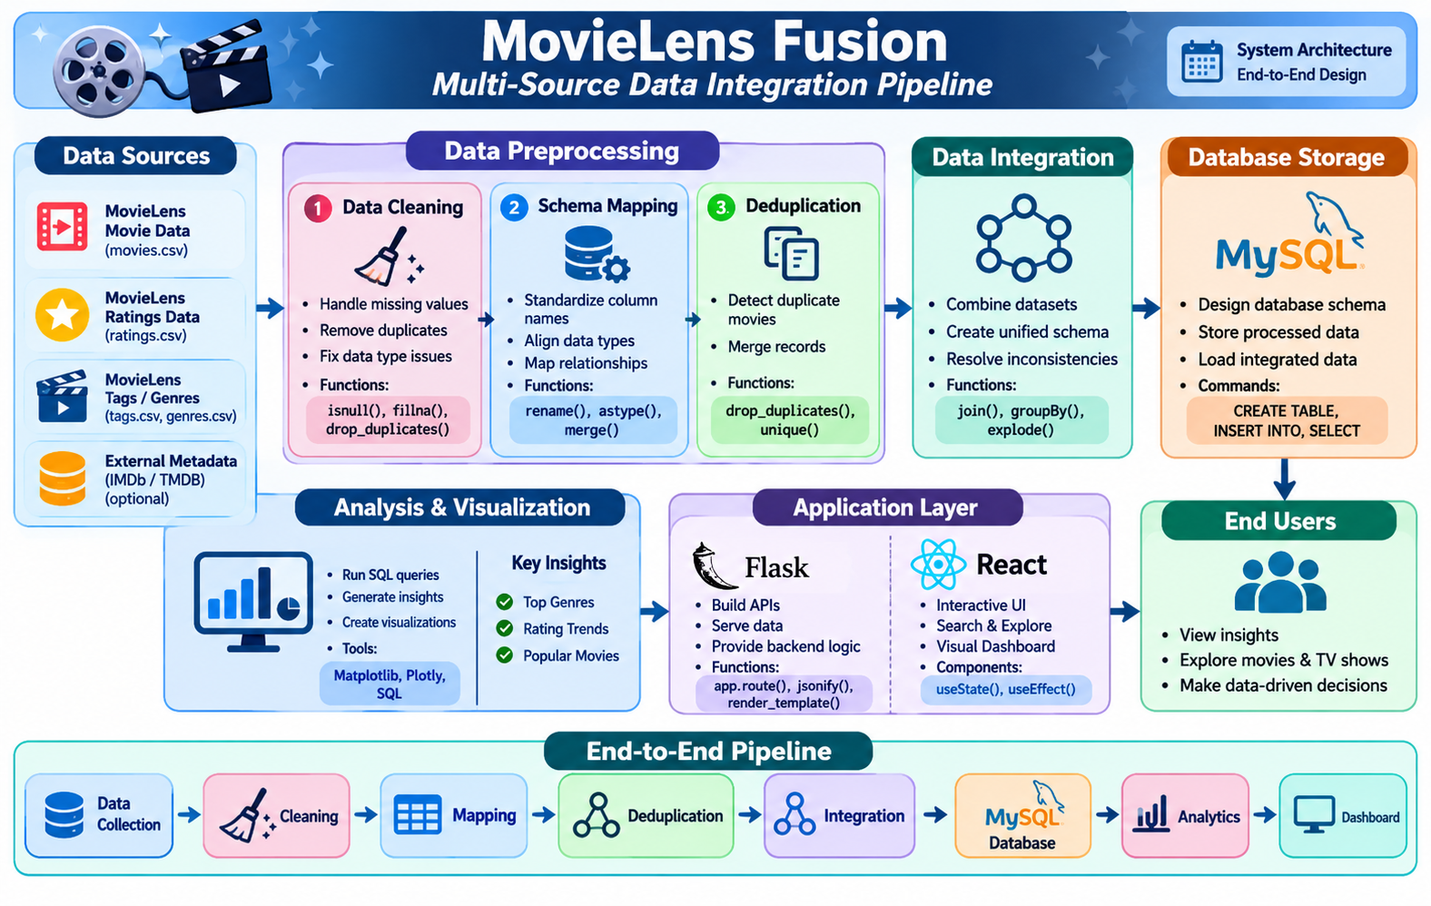

Slide 11
THANK YOU

